Slide 1


Slide 2
Design and Implementation
Presented By:
Rana Shoaib(12275)
Muhammad Hashir Waheed(12274)
Zohaib Hassan(12276)

Slide 3
Contents
Object Oriented Design using the UML
Design Patterns
Implementation Issues
Open Source Development

Slide 4
Design and Implementation
Software design and implementation is the stage in the software engineering process at which an executable software system is developed.
Software design is a creative activity in which you identify software components and their relationships, based on a customer’s requirements.
Software implementation is the process of realizing the design as a program.

Slide 5
Design Process Stages
Common activities in these processes include:
Define the context and modes of use of the system;
Design the system architecture;
Identify the principal system objects;
Develop design models;
Specify object interfaces.

Slide 6
System Context Interaction
A system context model is a structural model that demonstrates the other systems in the environment of the system being developed.
An interaction model is a dynamic model that shows how the system interacts with its environment as it is used.

Slide 7
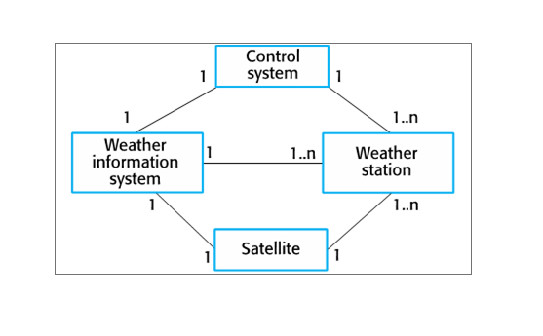
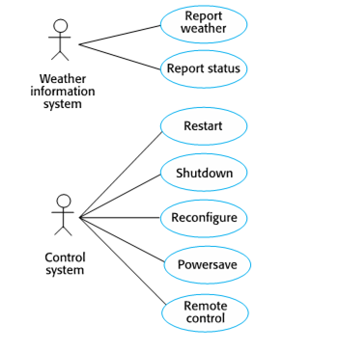
System Context and Use Case for weather station

Slide 8
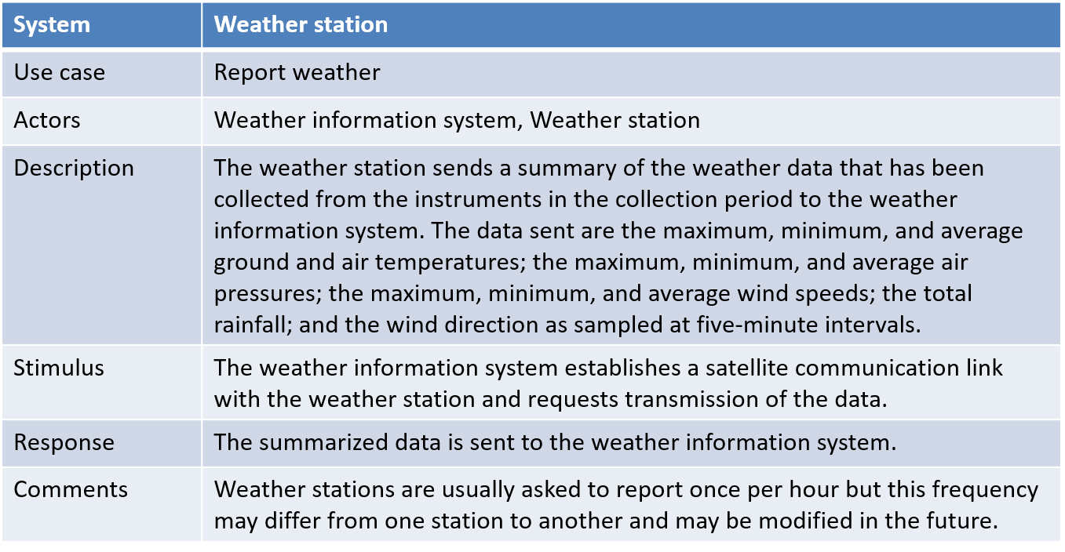
Use Case Description

Slide 9
Design models
Design models show the objects and object classes and relationships between these entities.
Static models describe the static structure of the system in terms of object classes and relationships.
Dynamic models describe the dynamic interactions between objects.

Slide 10
Types of design models
Subsystem models that show logical groupings of objects into coherent subsystems.
Sequence models that show the sequence of object interactions.
State machine models that show how individual objects change their state in response to events.
Other models include use-case models, aggregation models, generalisation models, etc.

Slide 11
Subsystem models
Shows how the design is organized into logically related groups of objects.
In the UML, these are shown using packages - an encapsulation construct. This is a logical model. The actual organization of objects in the system may be different.

Slide 12

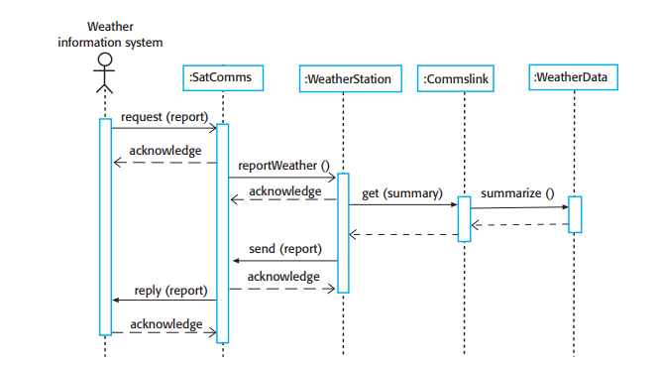
Sequence models
Sequence models show the sequence of object interactions that take place
Objects are arranged horizontally across the top;
Time is represented vertically so models are read top to bottom;
Interactions are represented by labelled arrows; different styles of arrow represent different types of interaction;
A thin rectangle in an object lifeline represents the time when the object is the controlling object in the system.

Slide 13
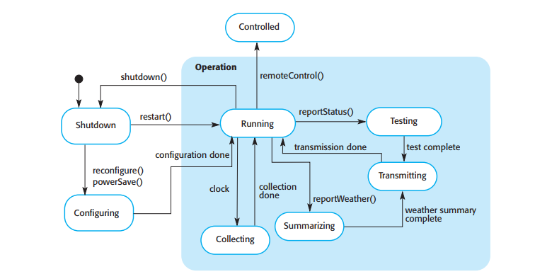
State diagrams
State diagrams are used to show how objects respond to different service requests and the state transitions triggered by these requests.
State diagrams are useful high-level models of a system or an object’s run-time behavior.

Slide 14
Design pattern
A design pattern is a way of reusing abstract knowledge about a problem and its solution.
A pattern is a description of the problem and the essence of its solution.
It should be sufficiently abstract to be reused in different settings.
Pattern descriptions usually make use of object-oriented characteristics such as inheritance and polymorphism.

Slide 15
Pattern elements
Name
A meaningful pattern identifier.
Problem description.
Solution description.
Not a concrete design but a template for a design solution that can be instantiated in different ways.
Consequences
The results and trade-offs of applying the pattern.

Slide 16
The Observer pattern
Name
Observer.
Description
Separates the display of object state from the object itself.
Problem description
Used when multiple displays of state are needed.
Solution description
See slide with UML description.
Consequences
Optimizations to enhance display performance are impractical.

Slide 17
Design problems
To use patterns in your design, you need to recognize that any design problem you are facing may have an associated pattern that can be applied.
Tell several objects that the state of some other object has changed (Observer pattern).
Tidy up the interfaces to a number of related objects that have often been developed incrementally (Façade pattern).
Provide a standard way of accessing the elements in a collection, irrespective of how that collection is implemented (Iterator pattern).
Allow for the possibility of extending the functionality of an existing class at run-time (Decorator pattern).

Slide 18
Implementation issues
Reuse Most modern software is constructed by reusing existing components or systems. When you are developing software, you should make as much use as possible of existing code.
Configuration management During the development process, you have to keep track of the many different versions of each software component in a configuration management system.
Host-target development Production software does not usually execute on the same computer as the software development environment. Rather, you develop it on one computer (the host system) and execute it on a separate computer (the target system).

Slide 19
Reuse
From the 1960s to the 1990s, most new software was developed from scratch, by writing all code in a high-level programming language.
The only significant reuse or software was the reuse of functions and objects in programming language libraries.
Costs and schedule pressure mean that this approach became increasingly unviable, especially for commercial and Internet-based systems.
An approach to development based around the reuse of existing software emerged and is now generally used for business and scientific software.

Slide 20
Reuse levels
The abstraction level
At this level, you don’t reuse software directly but use knowledge of successful abstractions in the design of your software.
The object level
At this level, you directly reuse objects from a library rather than writing the code yourself.
The component level
Components are collections of objects and object classes that you reuse in application systems.
The system level
At this level, you reuse entire application systems.

Slide 21
Configuration management
Configuration management is the name given to the general process of managing a changing software system.
The aim of configuration management is to support the system integration process so that all developers can access the project code and documents in a controlled way, find out what changes have been made, and compile and link components to create a system.

Slide 22
Configuration management activities
Version management, where support is provided to keep track of the different versions of software components. Version management systems include facilities to coordinate development by several programmers.
System integration, where support is provided to help developers define what versions of components are used to create each version of a system. This description is then used to build a system automatically by compiling and linking the required components.
Problem tracking, where support is provided to allow users to report bugs and other problems, and to allow all developers to see who is working on these problems and when they are fixed.

Slide 23
Open source development
Open source development is an approach to software development in which the source code of a software system is published and volunteers are invited to participate in the development process
Open source software extended this idea by using the Internet to recruit a much larger population of volunteer developers. Many of them are also users of the code.

Slide 24
Open Source Systems
The best-known open source product is the Linux operating system which is widely used as a server system and, increasingly, as a desktop environment.
Other important open source products are Java, the Apache web server and the MySQL database management system.

Slide 25
Open Source licensing
A fundamental principle of open-source development is that source code should be freely available, this does not mean that anyone can do as they wish with that code.
Legally, the developer of the code (either a company or an individual) still owns the code. They can place restrictions on how it is used by including legally binding conditions in an open source software license.
Some open source developers believe that if an open source component is used to develop a new system, then that system should also be open source.
Others are willing to allow their code to be used without this restriction. The developed systems may be proprietary and sold as closed source systems.

Slide 26



Thought of the day

